Slide 1
Global climate observations
Silvia Caldararu
Email: caldaras@tcd.ie

Slide 2

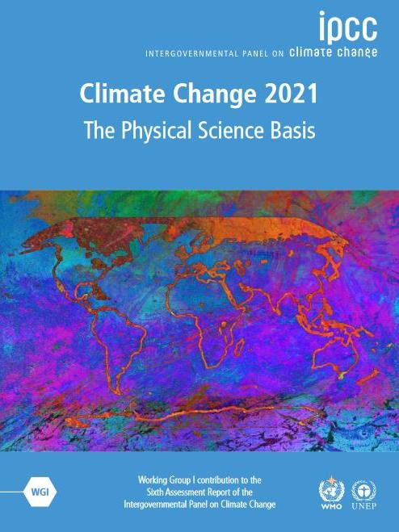
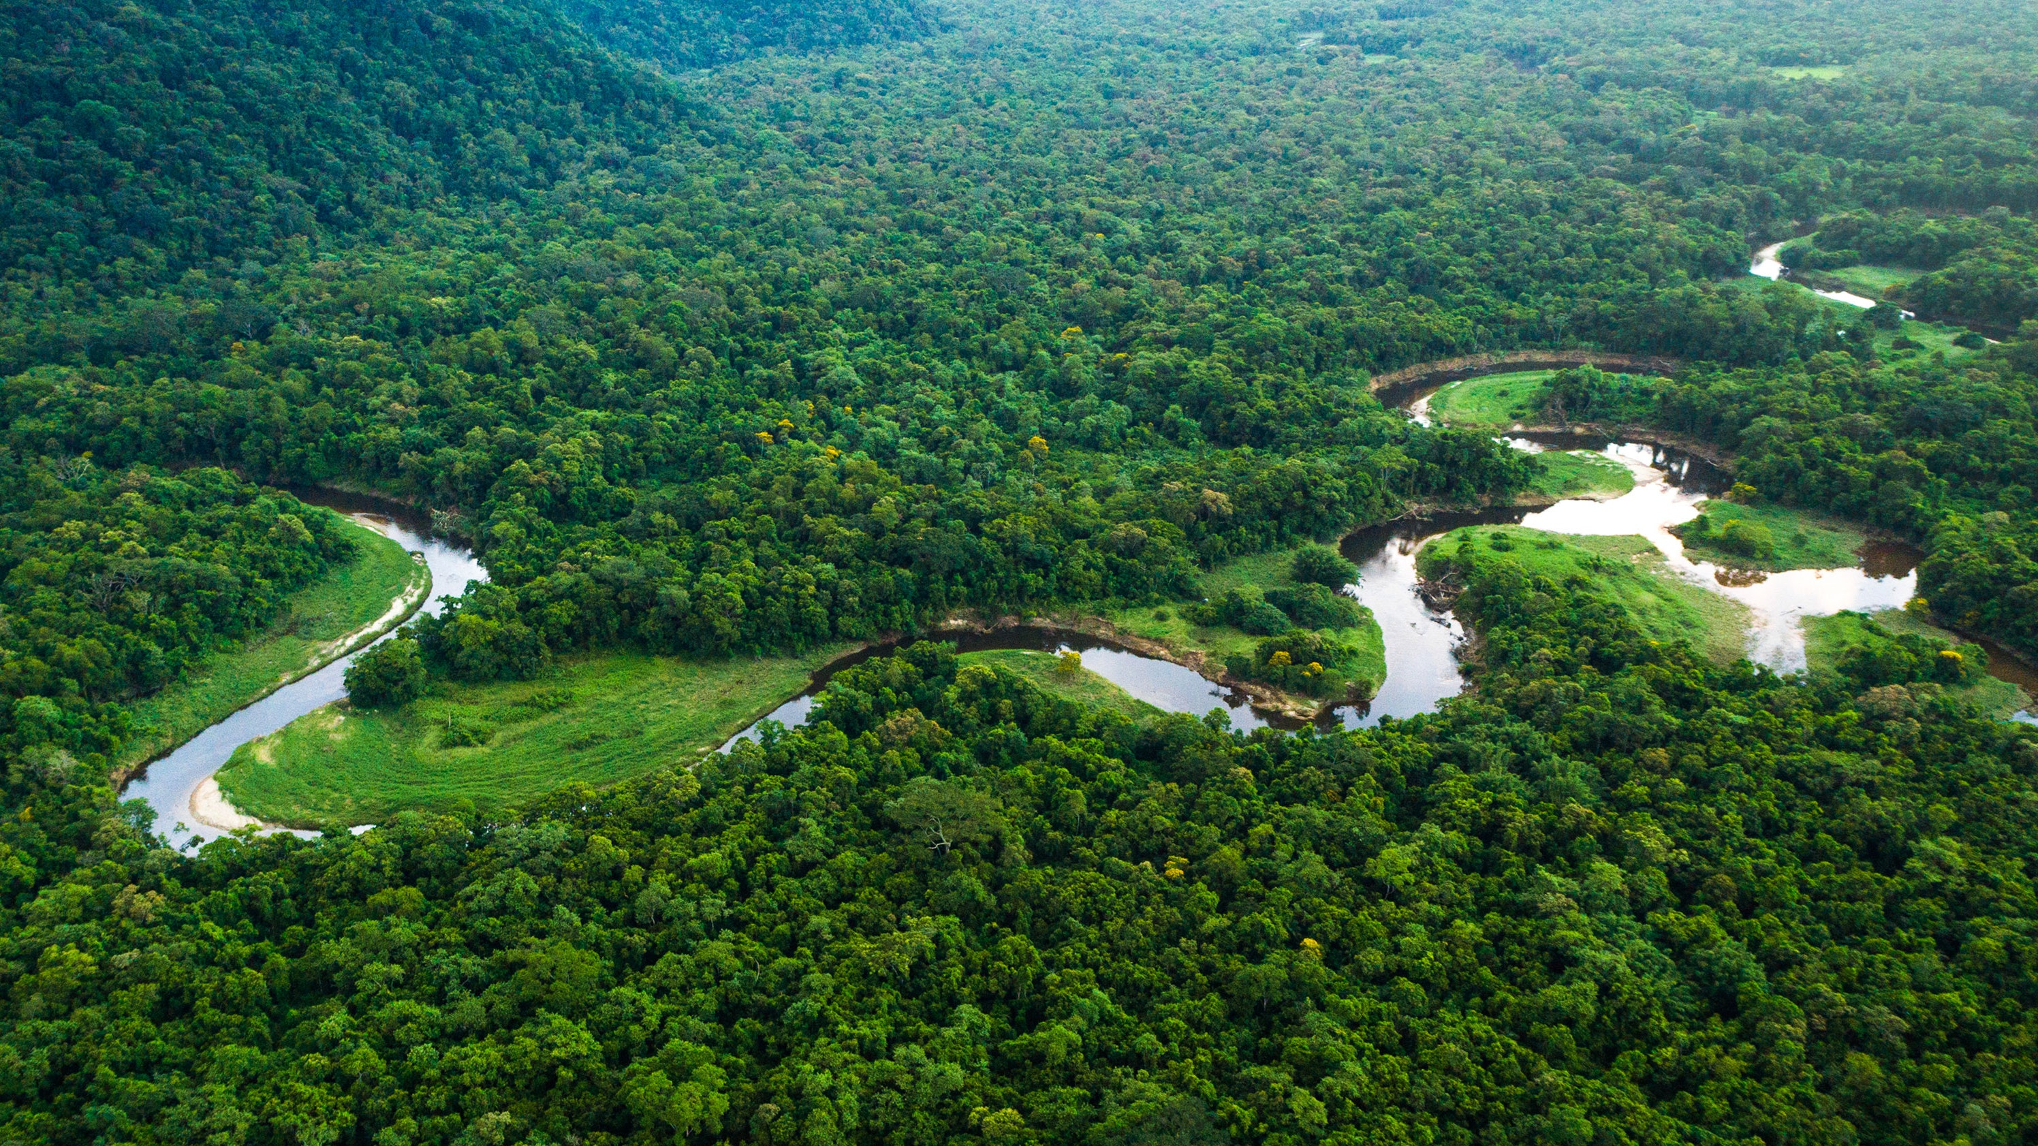

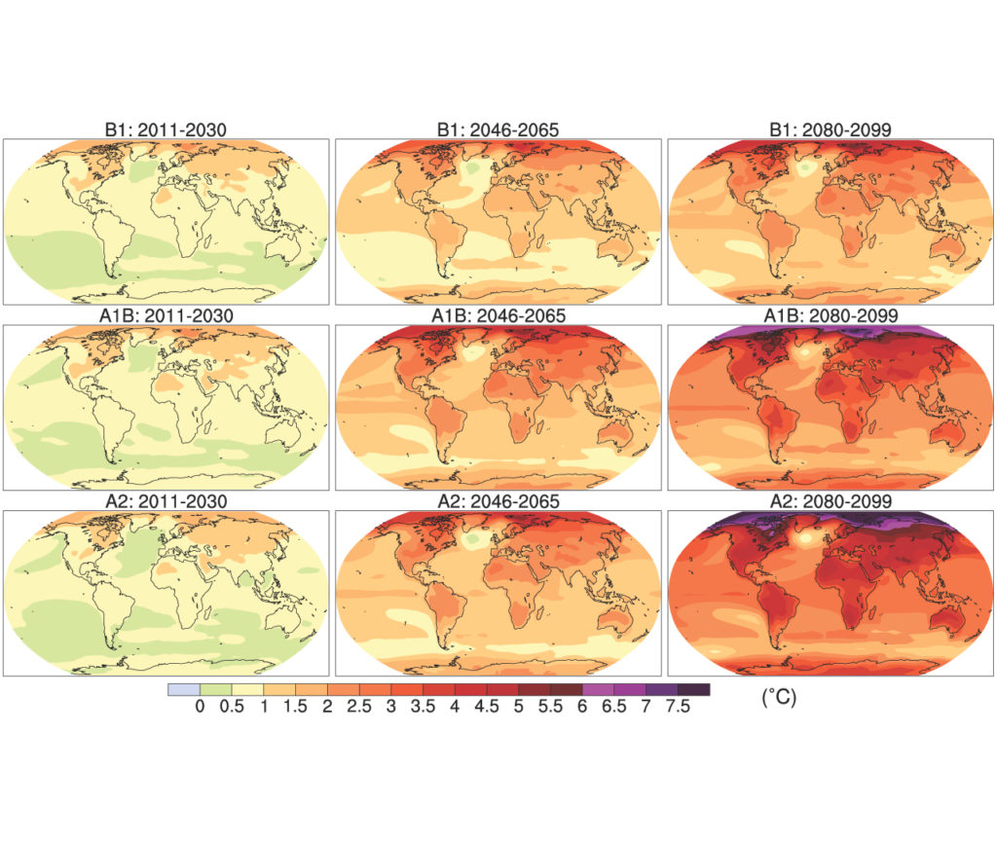
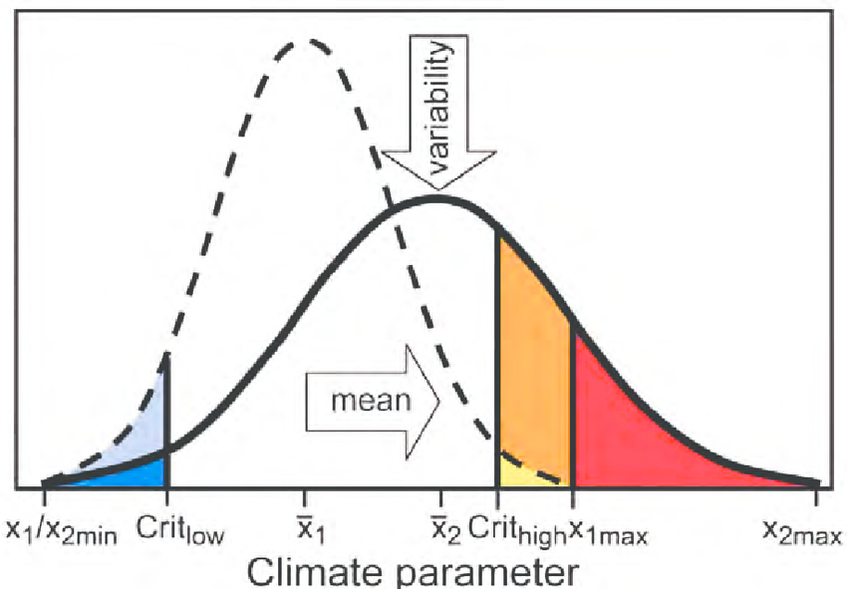
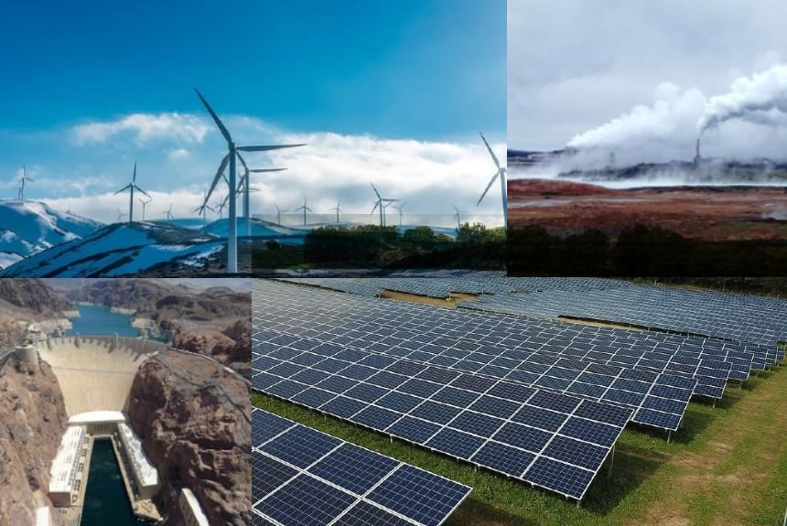
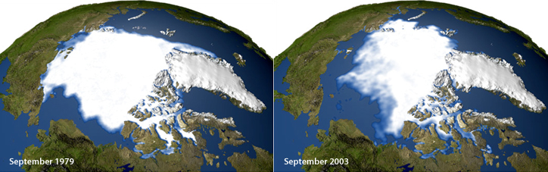
Atmosphere
Climate fundamentals
Predicting climate
Atmosphere
Global C cycle
IPCC report
Earth system models
Climate impacts
Climate solutions
Extreme events
Tipping points
Sea ice, ice caps,
Energy
Mitigation
Nature-based solutions

Slide 3
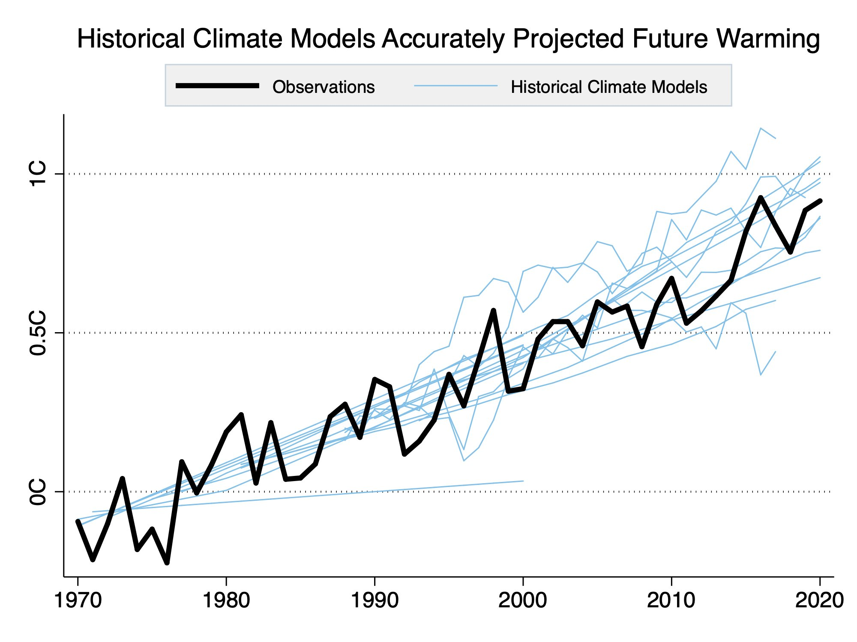
If they’re so varied, how do we know the models are right?
All models are tested against historical data before used for future projections
Lecture 11 - Uncertainty

Slide 4
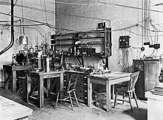
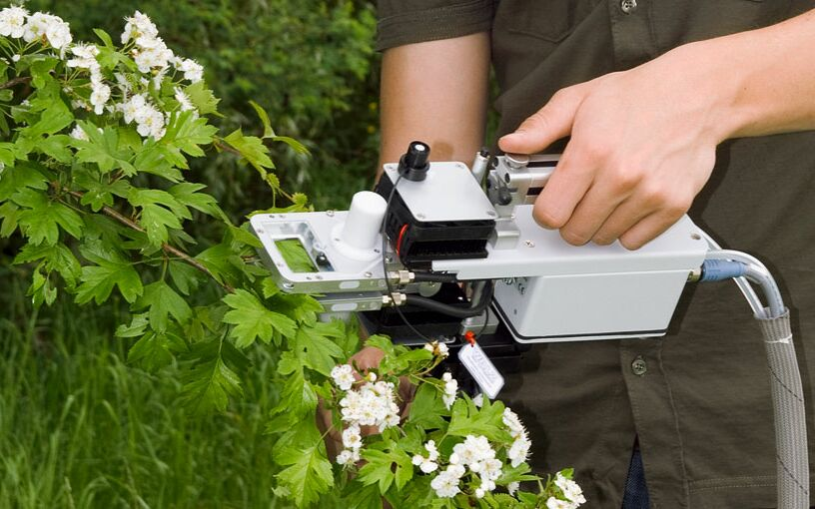
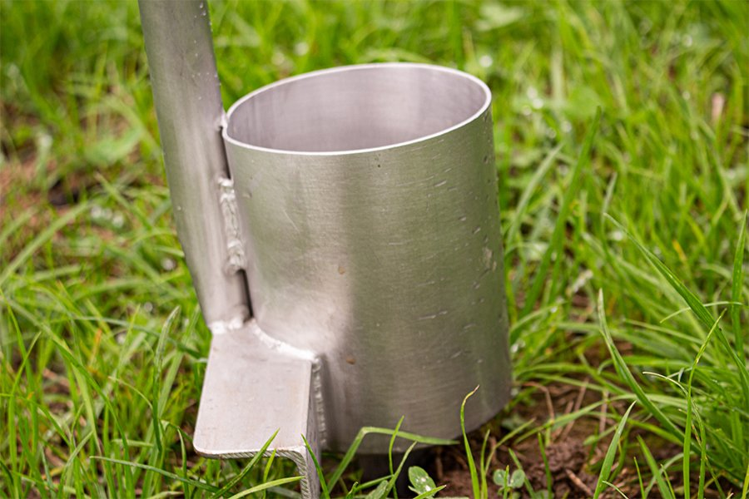
Traditional experiments are small scale
Lab experiment
Field – organismal or site level

Slide 5
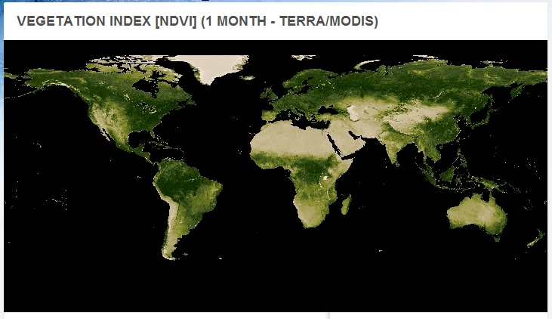

Process uncertainty – a question of scale
Approximation
Knowledge at plant level, measurements at plant and ecosystem level, model at global level

Slide 6
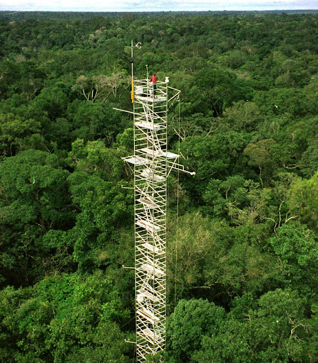
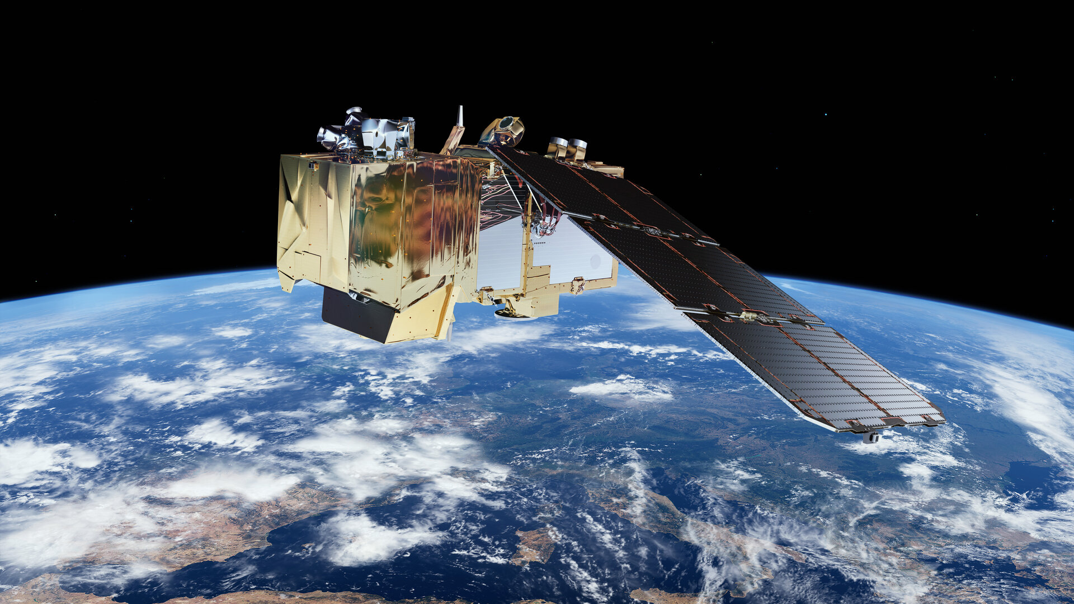
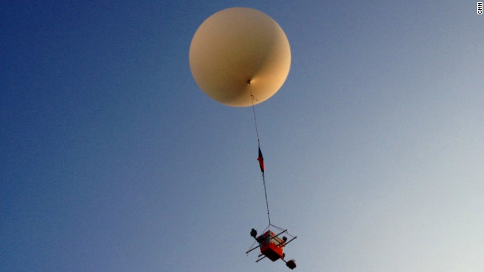
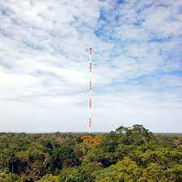
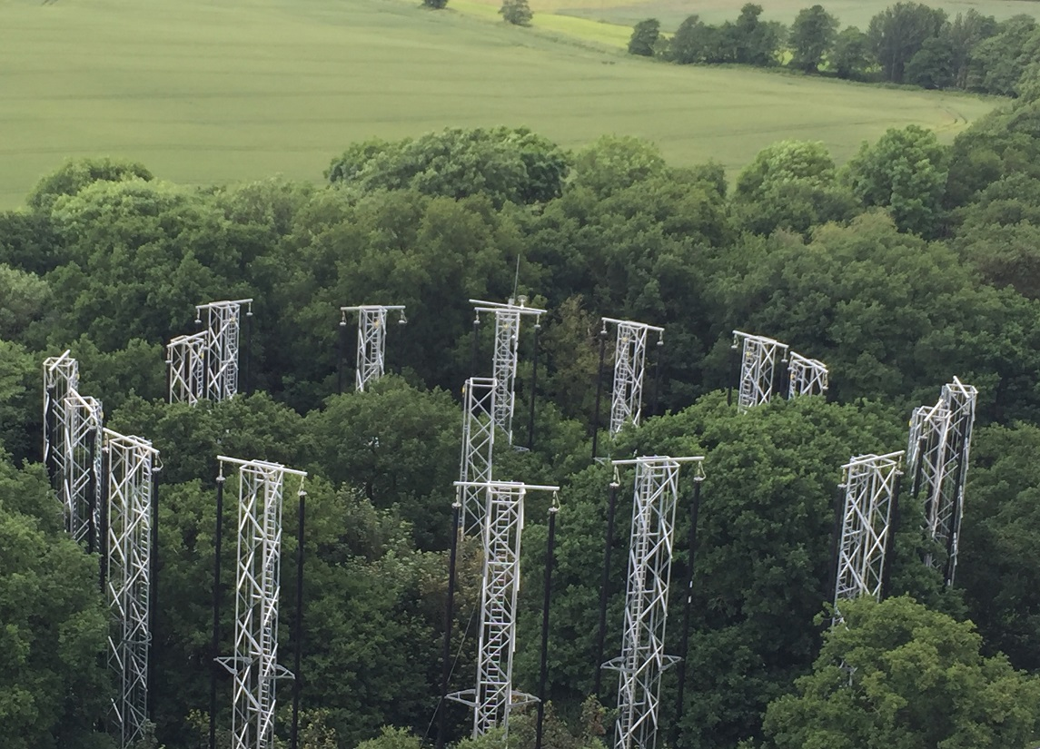
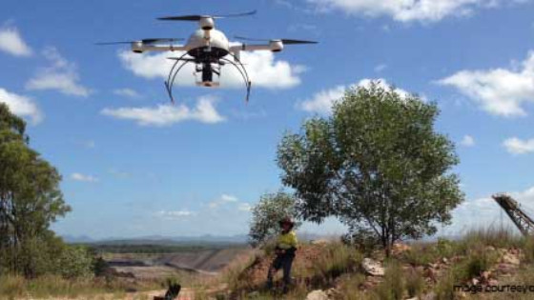
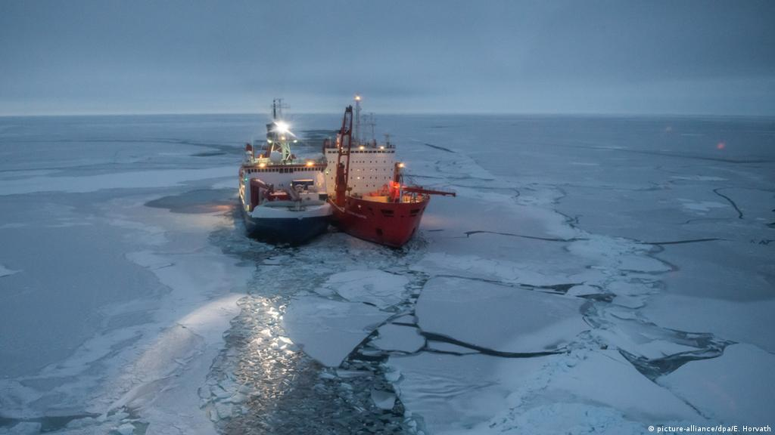
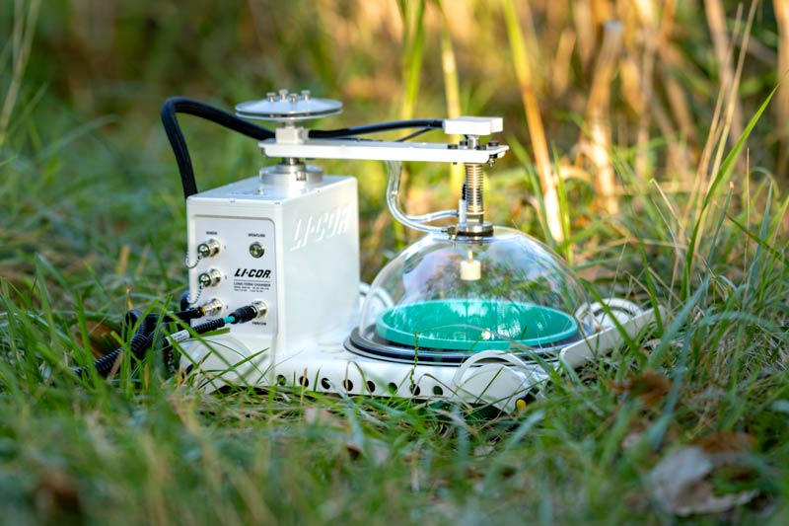
The data revolution

Slide 7
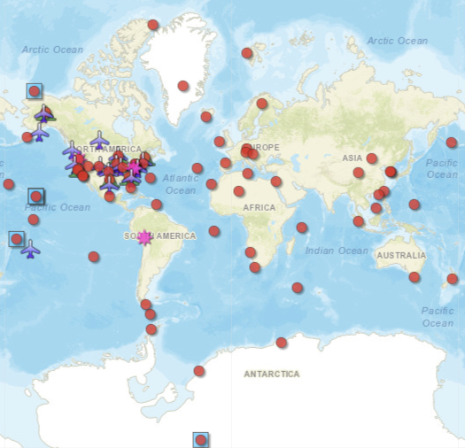
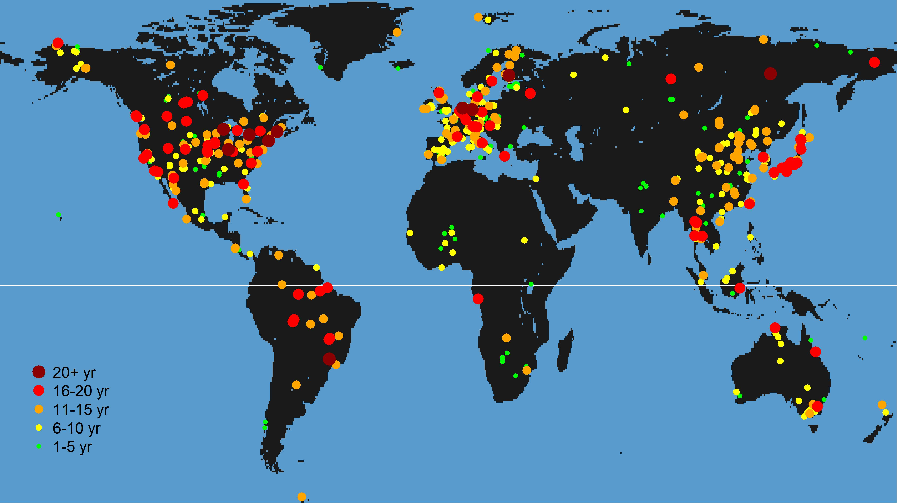
Observational networks
Atmospheric observations
FLUXNET – carbon flux measurements
Networks of sites with the same measurement protocols and data processing

Slide 8
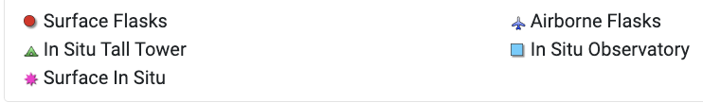
Atmospheric CO₂ concentrations: flask measurements

Slide 9
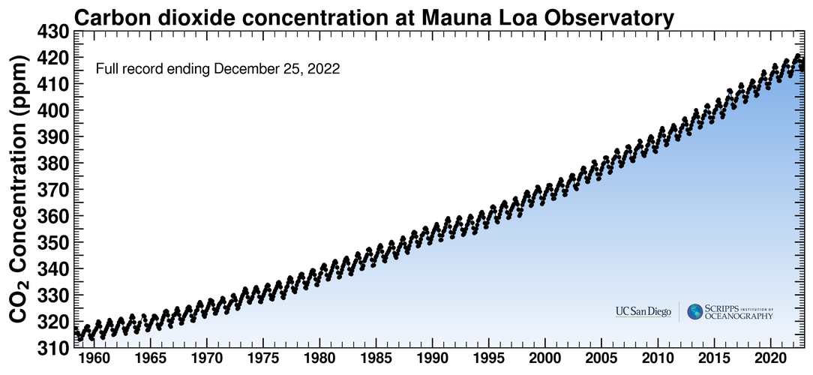
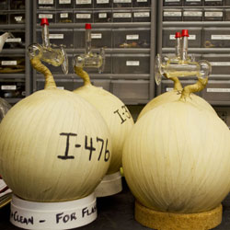
Atmospheric CO₂ concentrations: flask measurements

Slide 10
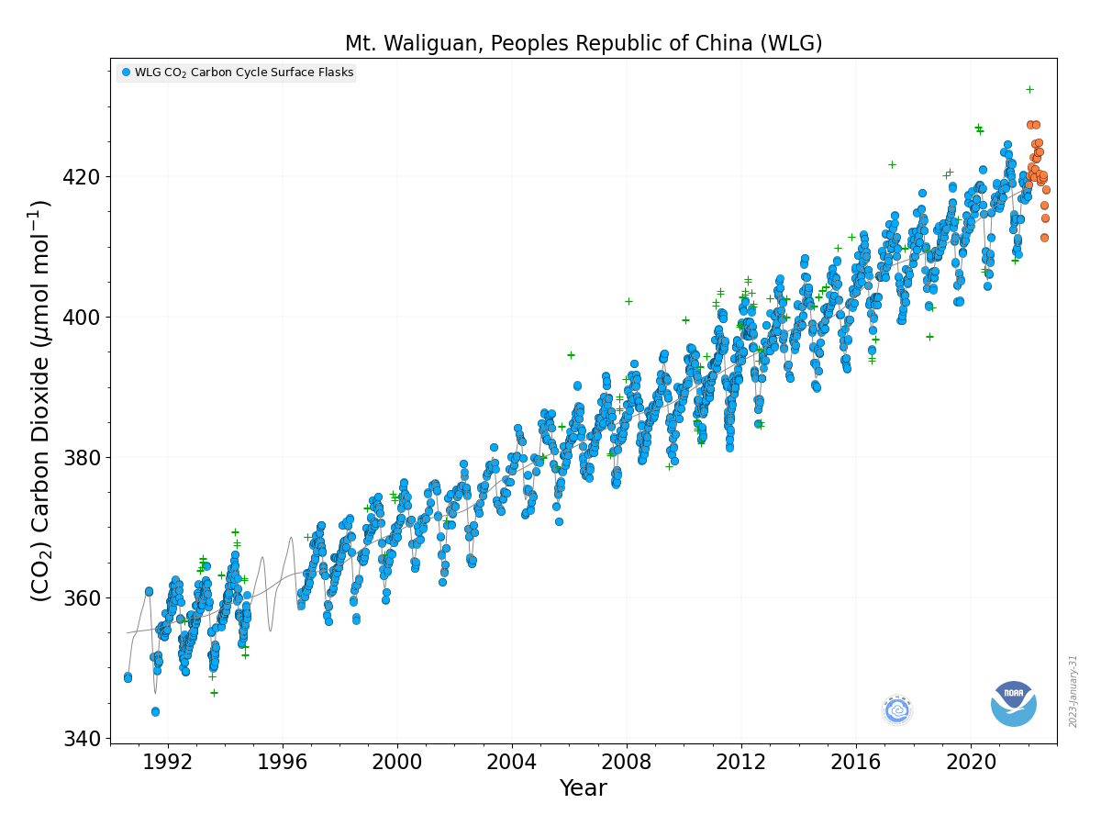
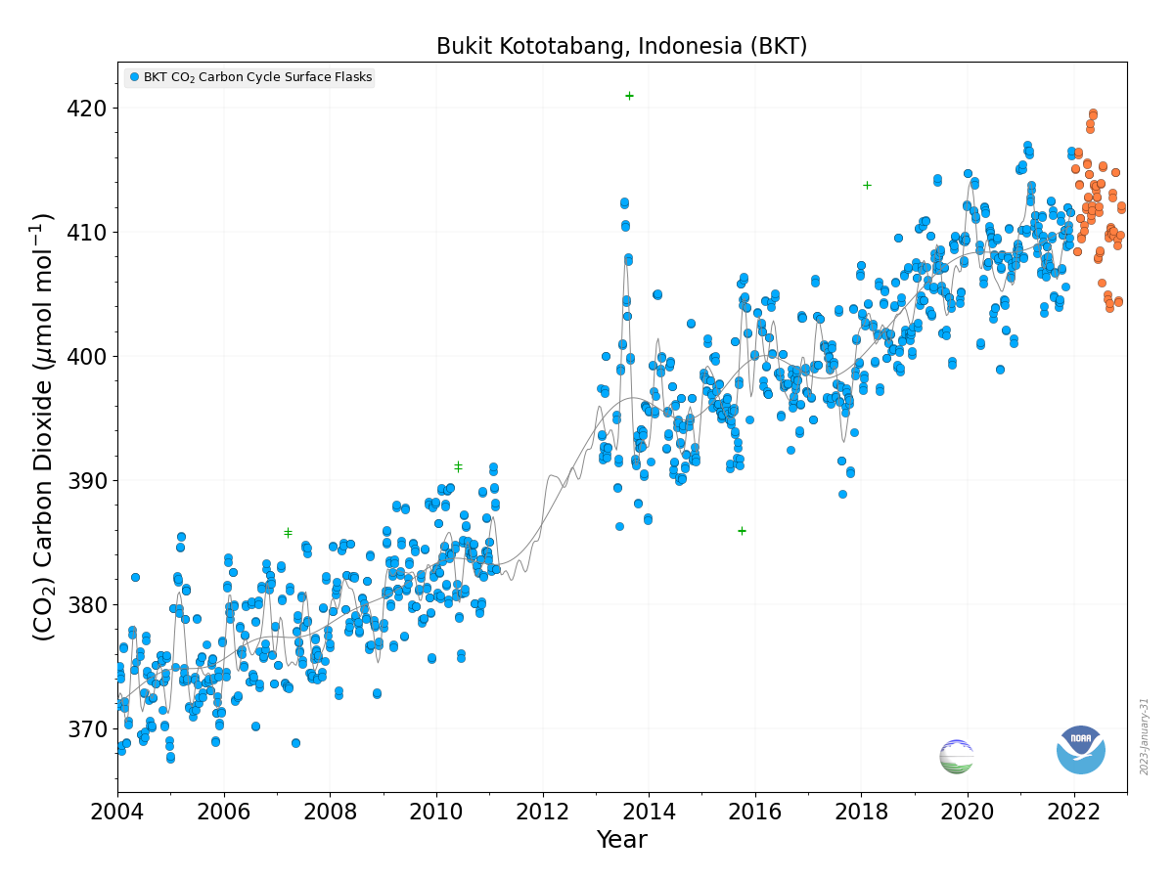
Atmospheric CO₂ concentrations: flask measurements

Slide 11
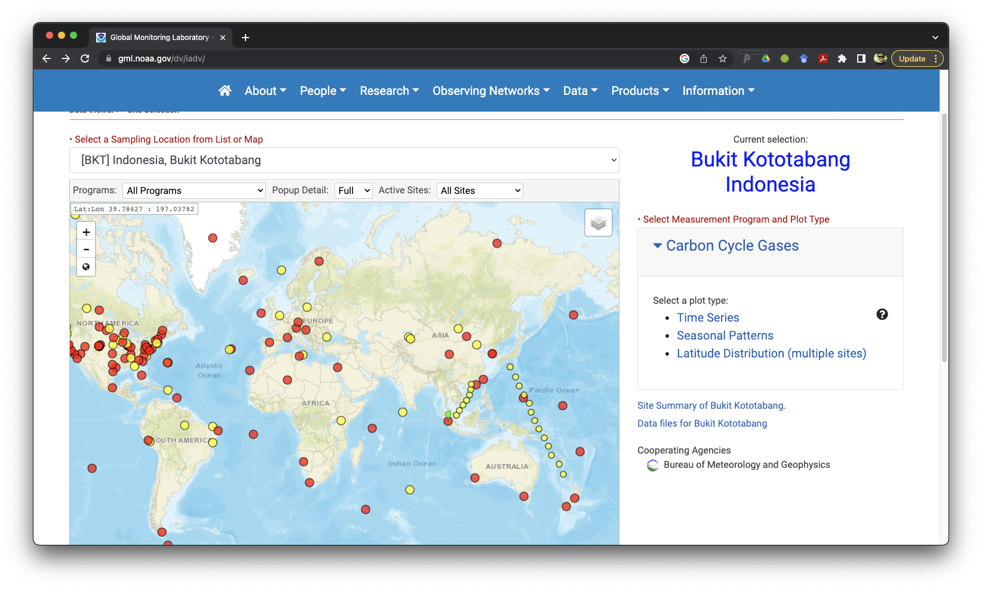
Atmospheric CO₂ concentrations: flask measurements
https://gml.noaa.gov/dv/iadv/

Slide 12
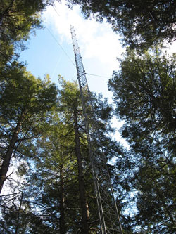
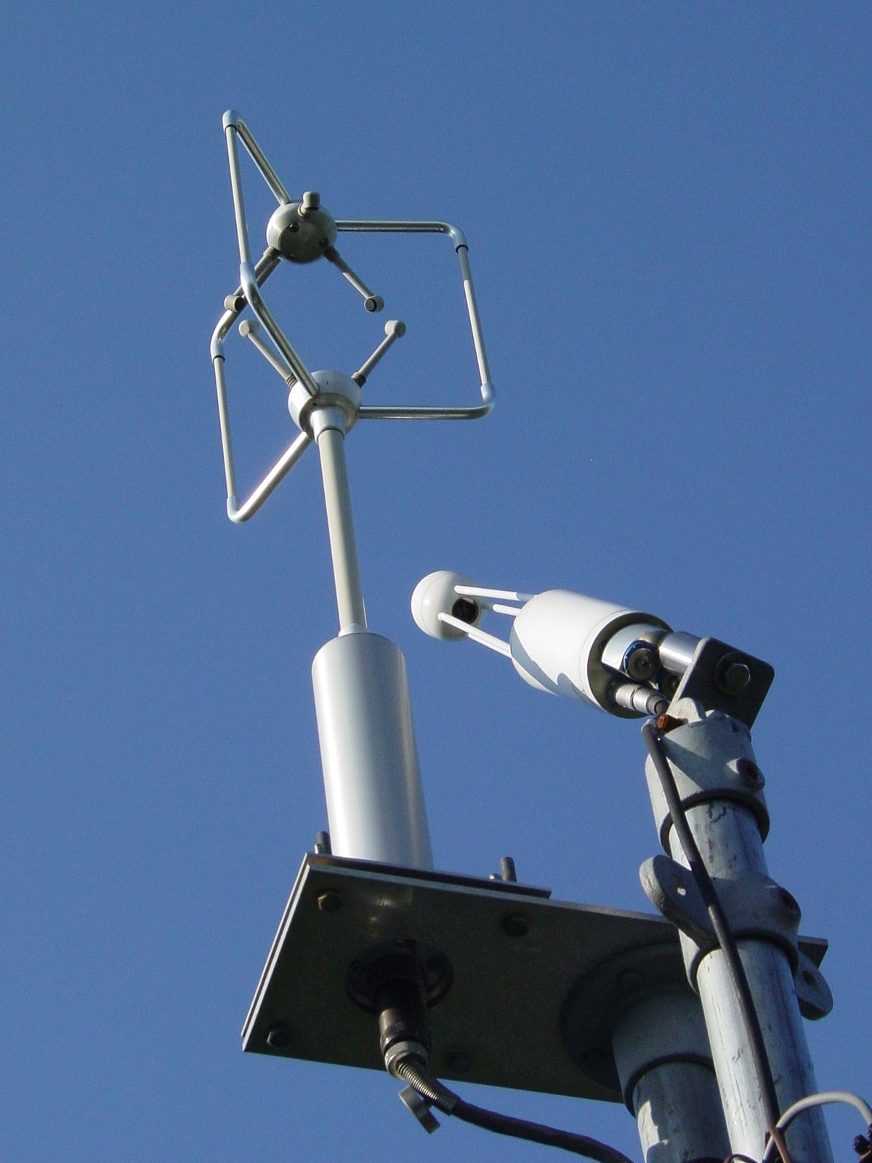
Ecosystem level CO₂ fluxes
CO₂ flux in and out of an ecosystem
Automatic, high temporal frequency
Measures of ecosystem level photosynthesis (GPP) and respiration

Slide 13
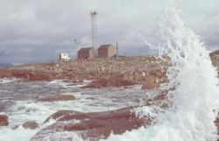
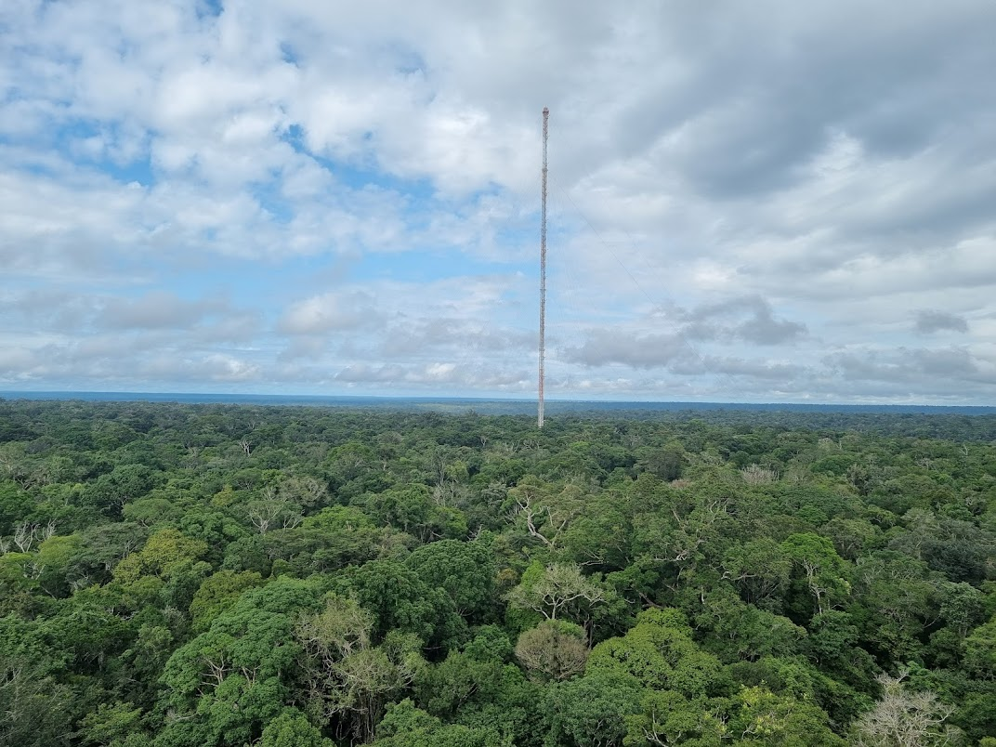
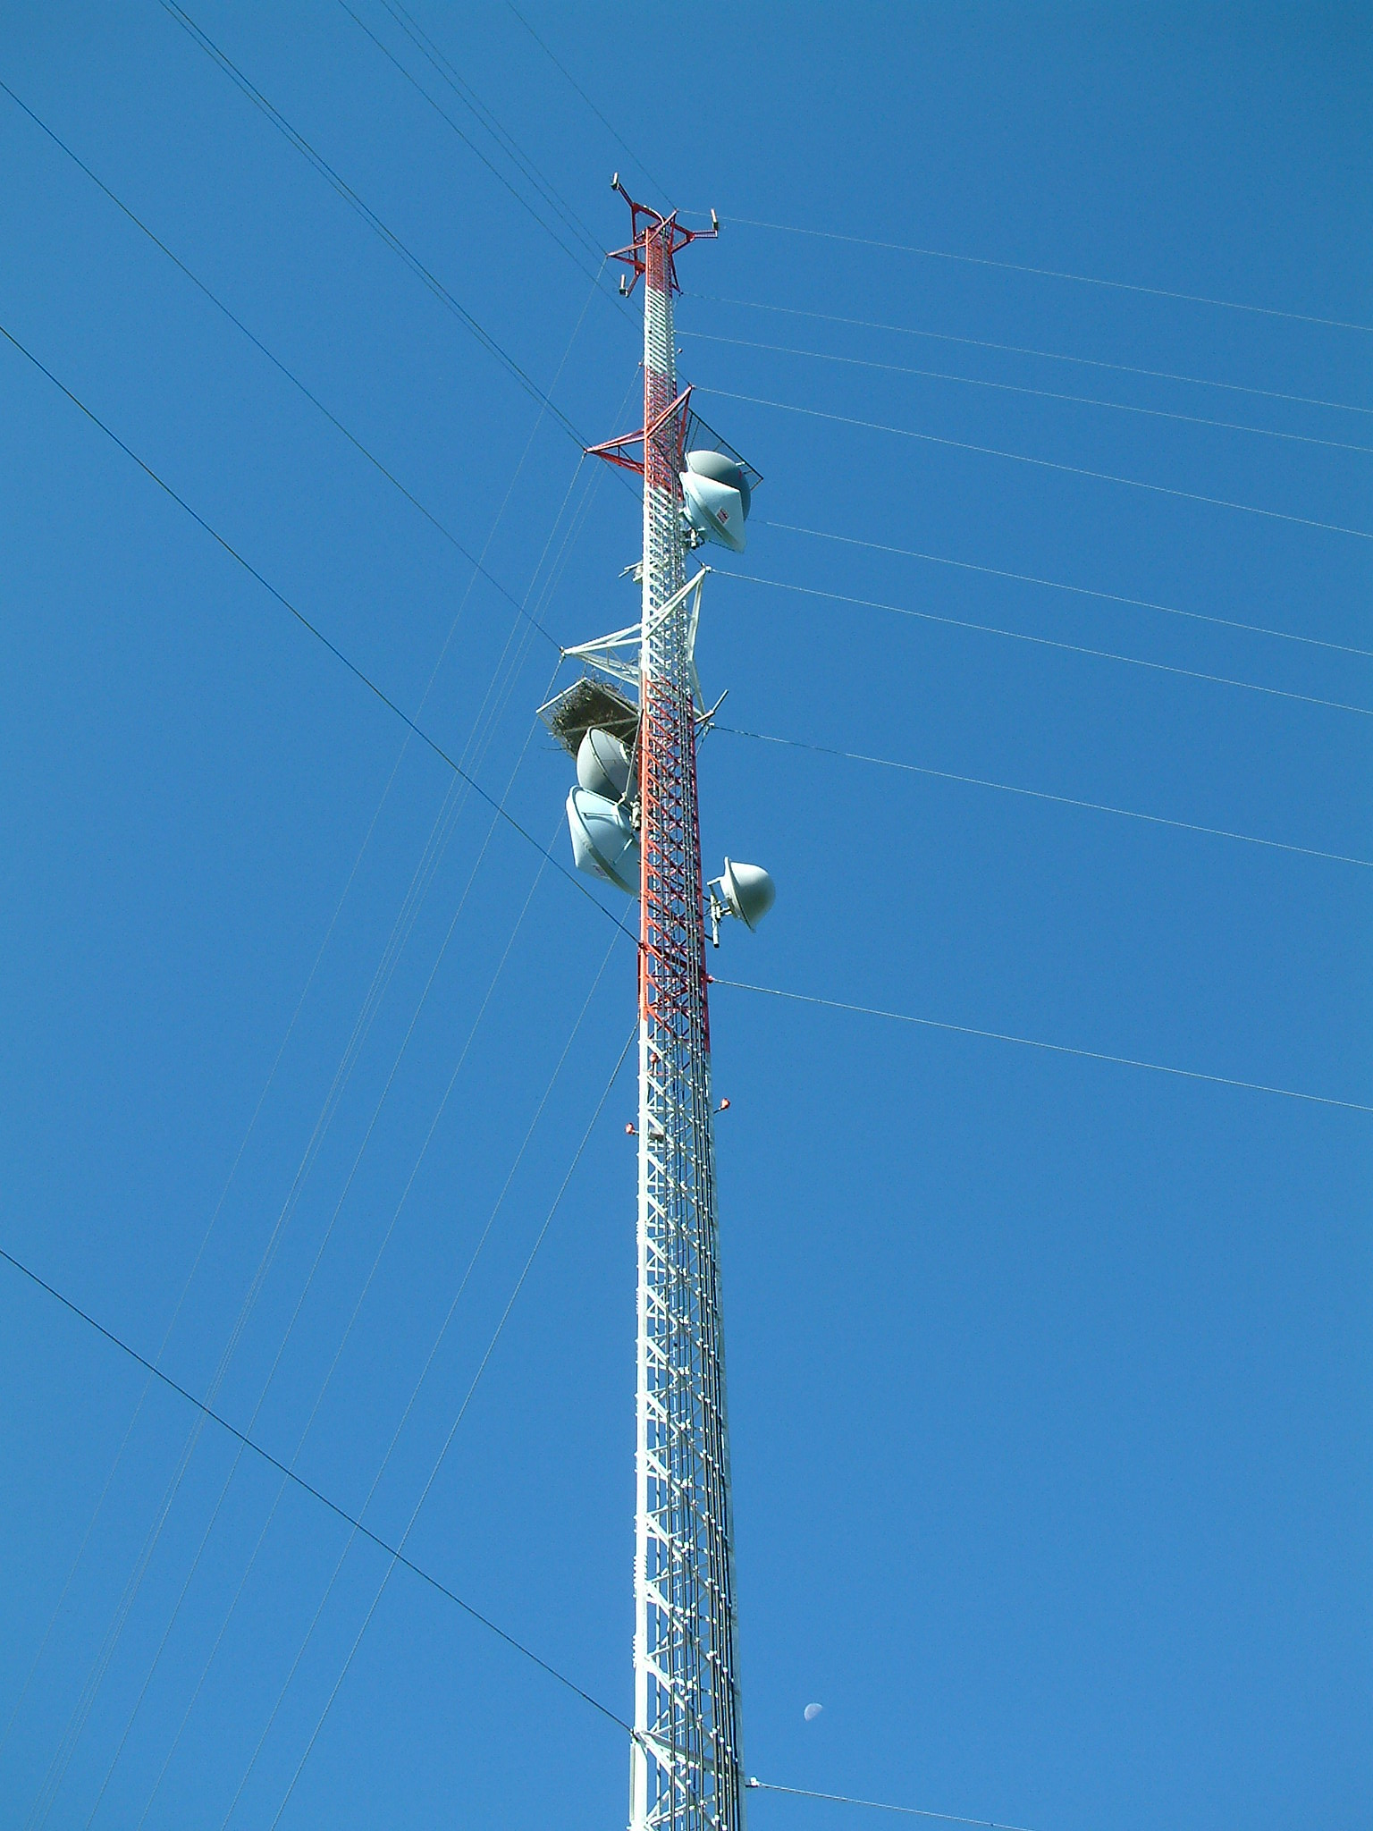
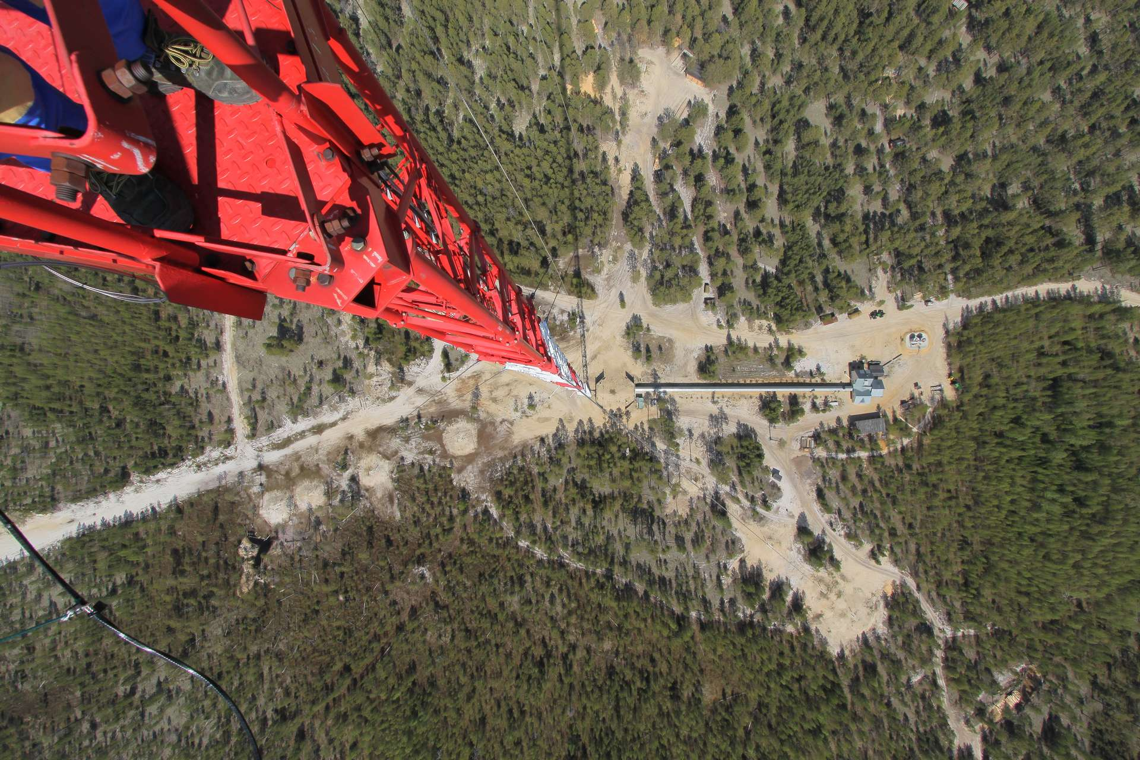
Atmospheric CO₂ concentrations: tall towers
Mace Head Ireland
Amazon Tall Tower Observatory
(ATTO)
Argyle Maine Tower US
Zotino Tall Tower observatory (ZOTTO)

Slide 14
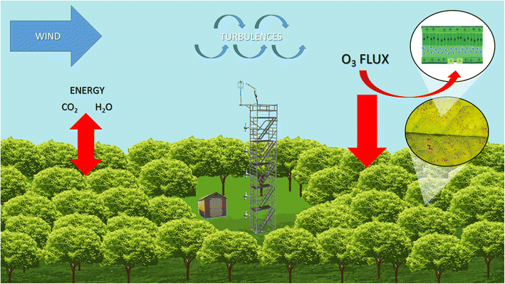
Atmospheric CO₂ concentrations: tall towers
Tall towers vs. short towers: tall towers measure regional concentrations

Slide 15
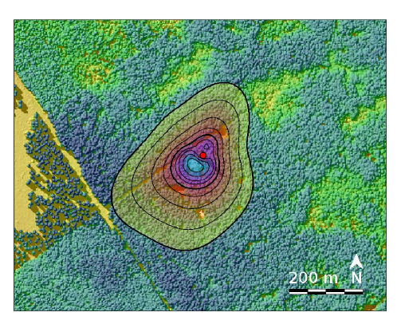
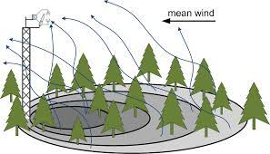
Atmospheric CO₂ concentrations: tall towers
A footprint is the area of which the CO₂ measurement is representative of. It depends on the predominant winds and the type of landscape surrounding the tower

Slide 16
Spatial bias

Slide 17
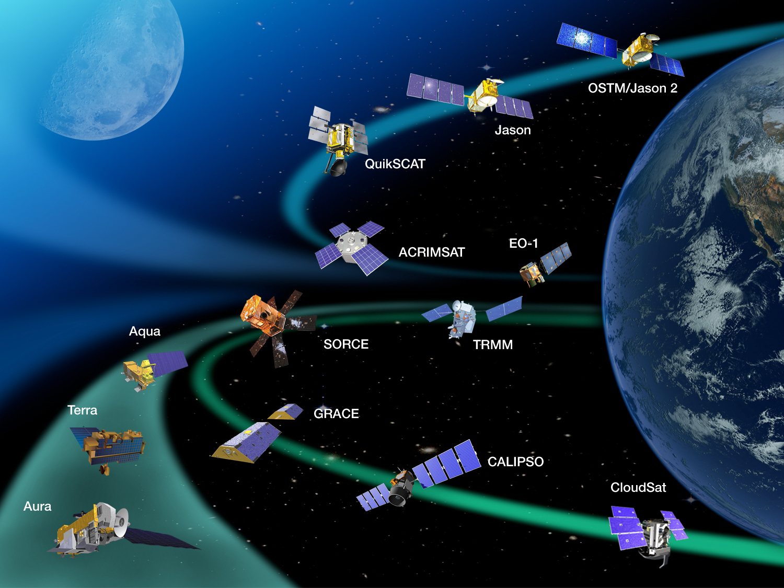
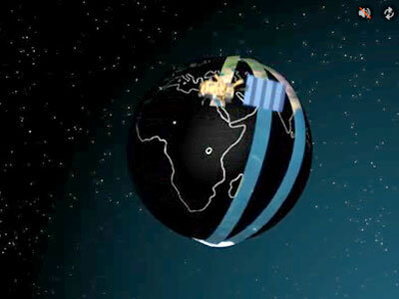
Satellite based remote sensing
Global extent
Relative coarse spatial resolution (but getting better)
Every 8-16 days (orbit restrictions)
Longest timeseries goes back to the 80s
Cannot measure through clouds

Slide 18
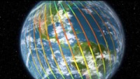
Atmospheric CO₂ concentrations: satellite measurements

Slide 19
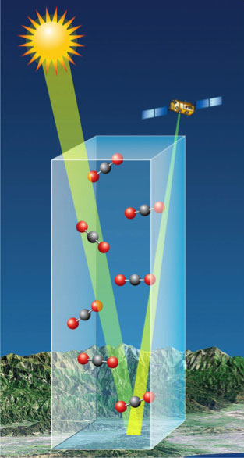
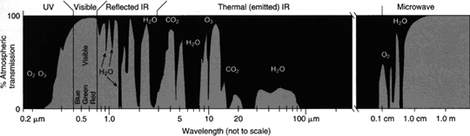
Atmospheric CO₂ concentrations: satellite measurements
Remote sensing measurements use reflected solar radiation to measure CO₂ concentrations based on the spectral properties of the atmosphere.

Slide 20
Atmospheric CO₂ concentrations: satellite measurements
VS.
Measuring different kinds of air masses at different spatial and temporal scales

Slide 21
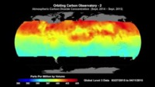
Atmospheric CO₂ concentrations: satellite measurements

Slide 22
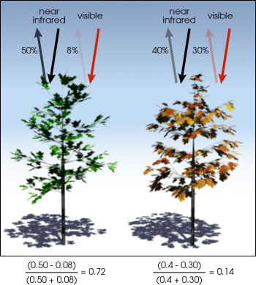
Remote sensing of greenness
Based on reflectance properties of the surface

Slide 23
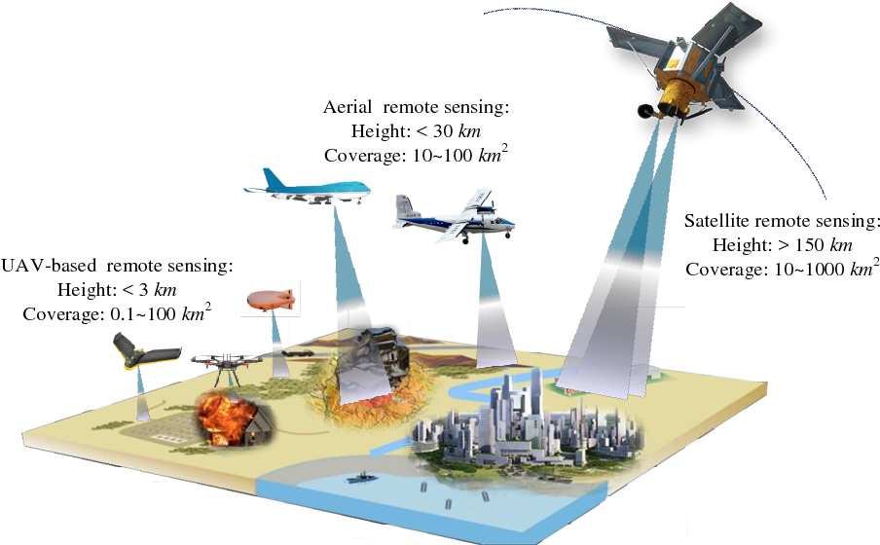
Drone and aircraft remote sensing
Same measurement principles as satellites
Higher spatial and temporal resolution
Smaller area and time period covered

Slide 24
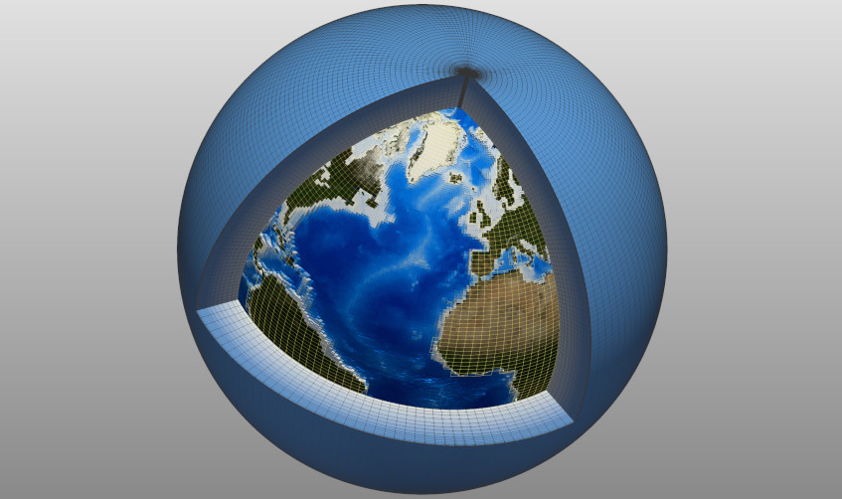
From local to global data for global challenges
Point measurements even in large databases

Slide 25
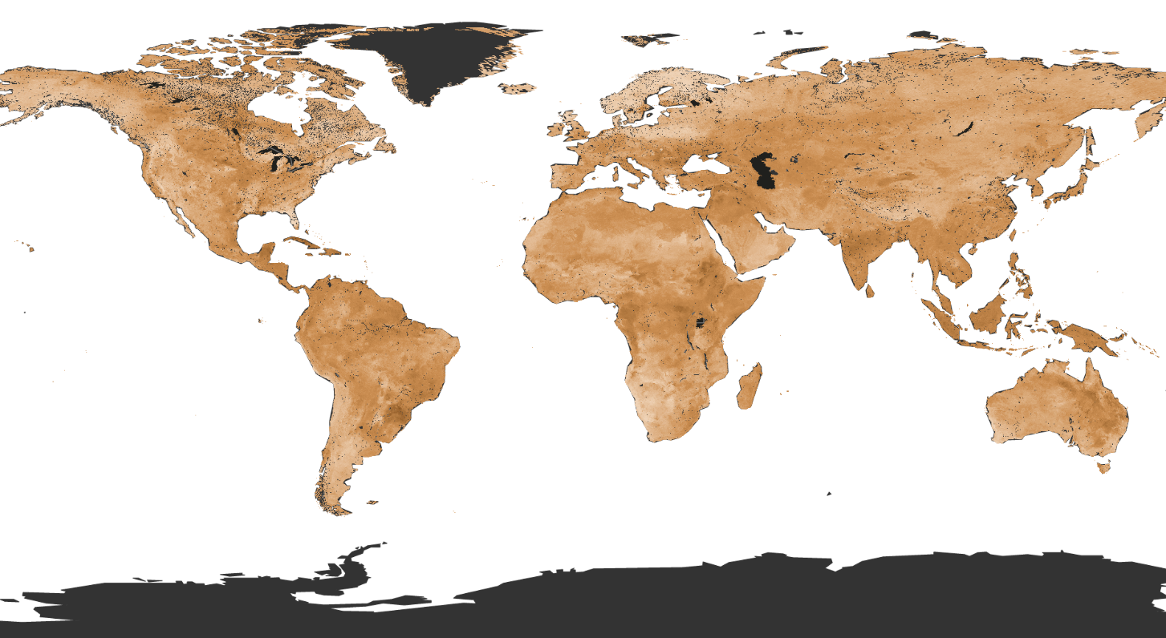
From local to global data for global challenges
Upscaling from point measurements using machine learning methods (AI)
Based on observed relationships with environmental variables
SoilGrids global soil variables

Slide 26

What is machine learning?
Complex statistical methods to analyse large, multi-variate data sets
Finding patterns in data
Black box methods

Slide 27
What is machine learning?
Classical model
Data
Model equations
Output
Machine learning
Data
Output

Slide 28
Machine learning for Earth System data
Machine learning
Data
Output
Site level observations
Explanatory variables:
Climate
Location
Ecosystem type
Global gridded data

Slide 29
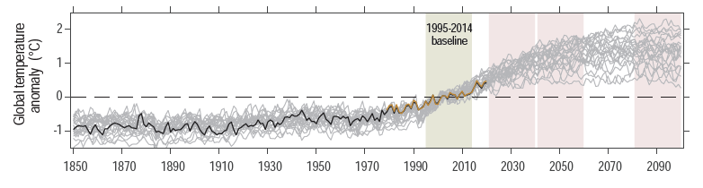
Extrapolating into future conditions
Observed conditions
New conditions
Assumption: the Earth system will behave in the same way under an altered climate as in past climate

Slide 30
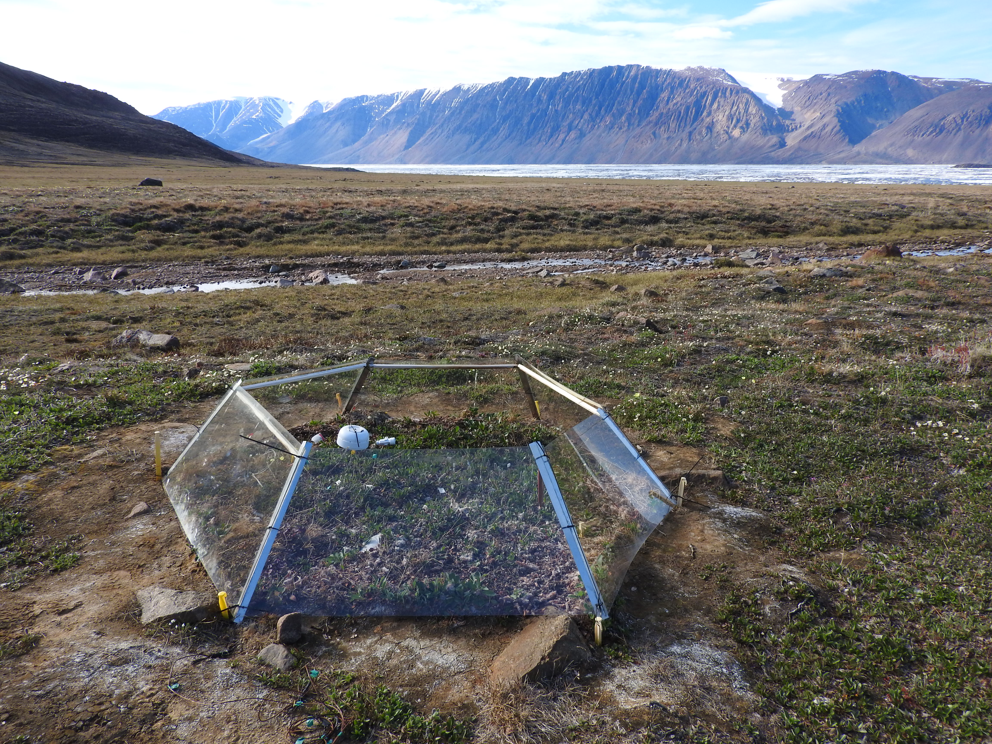
Simulating future conditions
Manipulate environment to create future conditions
High CO₂ experiments
Warming experiments

Slide 31
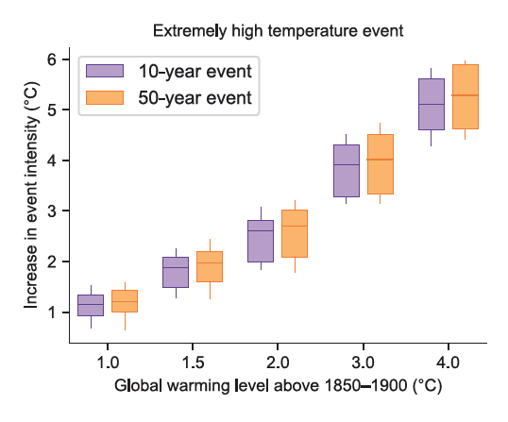
Extrapolating to extreme events
Extreme events are rare and might not be in the observational record

Slide 32
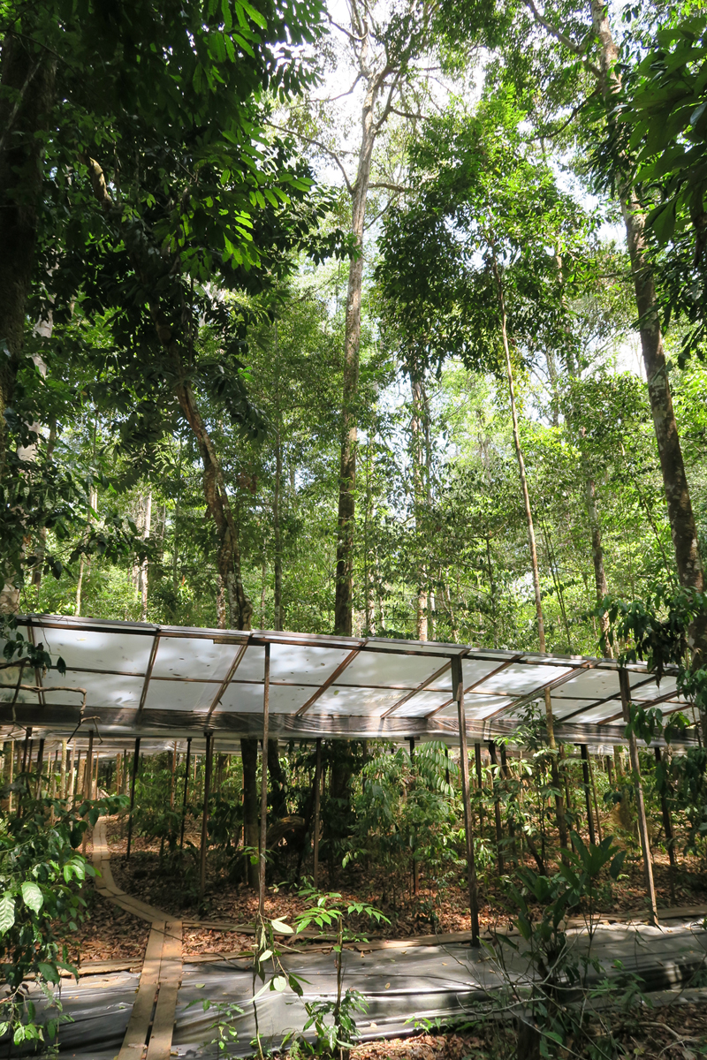

Simulating extreme events
Simulated drought (most frequent) or storm impacts

Slide 33
Data at different scales together with models

Slide 34
Atmosphere
Climate fundamentals
Predicting climate
Atmosphere
Global C cycle
IPCC report
Earth system models
Climate impacts
Climate solutions
Extreme events
Tipping points
Sea ice, ice caps,
Energy
Mitigation
Nature-based solutions

